Slide 1


Smart Home Controller
ATmega32-Based Embedded Systems Project
Date: 2026-08-30
Project Team
Soha Hossam Operating Modes
Yasseen Ahmed Elsayed Authentication & System Configuration
Khaled Real-time Monitor
Roaya Alarm System
Aya Event Log

Slide 2


Project Overview
What We Built
A complete smart home control system engineered utilizing the robust ATmega32 microcontroller.
Key Capabilities
▹
Secure password-protected access
▹
Manual and automatic device control
▹
Sensor-driven automation (Temperature & Light)
▹
Multi-source alarm system
▹
Persistent event logging
▹
Real-time, non-blocking operation
Build Status: Compiles Successfully Flash: 26% used | SRAM: 24% used

Slide 3
Hardware Architecture: Inputs & Sensors
Category | Component | Connection | Purpose
Controller | ATmega32 | - | Main system processing unit
Display | LCD 16x2 | Port B (Ctrl), Port D (Data) | Primary user interface display
Input | Keypad 4x4 | Port C | User input & password entry
Input | Push Button | PD2 (INT0) | Hardware emergency alarm trigger
Sensor | LM35 | PA0 (ADC0) | Analog temperature sensing
Sensor | LDR | PA1 (ADC1) | Ambient light level sensing

Slide 4
Hardware Architecture: Actuators & Comms
Category | Component | Connection | Purpose
Output | LED | PA2 | Simulated room lighting
Output | Relay 1 | PA3 | High-power Fan / AC control
Output | Relay 2 | PA4 | Automated Door lock control
Output | Buzzer | PA5 | Audible alarm sound generation
Comms | UART | PD0 (RX), PD1 (TX) | PC terminal debugging & log extraction
Memory | Internal EEPROM | - | Non-volatile storage for password, config, logs

Slide 5


Module 1: User Authentication (Yasseen)
Security Protocols
Core API & Event Tracking
The system implements robust access control to ensure only authorized users can manipulate the environment.
Key Firmware Functions:
▹
AUTH_Init() - Loads/initializes password from EEPROM at boot.
▹
Secured by a robust 4-digit PIN password.
AUTH_VerifyPassword() - Securely validates user input against memory.
▹
▹
Credentials stored safely in EEPROM (addresses 0x00-0x03).
▹
AUTH_SetPassword() - Protected API for credential updates via admin menu.
▹
Strict tracking of failed authentication attempts.
Monitored Events:
▹
Automatic system lockout after 3 consecutive failed tries.
Login Success
Immediate hardware alarm trigger upon system lockout.
▹
Login Failure Warning
▹
▹
Critical System Lockout

Slide 6






Module 2: Operating Modes (Soha)
Manual Mode
Automatic Mode
Configuration
Enables direct, user-driven environmental control via the 4x4 keypad interface.
Sensor-driven logic overrides manual input to maintain environmental parameters.
Dynamic adjustment of system parameters without recompiling code.
•
Room Lights (PA2 - LED)
•
Temp (LM35): Auto-enables Fan over threshold.
•
Temperature limits are user-configurable.
•
Fans/AC (PA3 - Relay)
•
Door Locks (PA4 - Relay)
•
Light (LDR): Auto-enables Room Lights in darkness.
•
Light sensitivity thresholds adjustable via Admin Menu.
•
Manual Alarm Toggle
•
Safety: Blocks manual commands to prevent state conflicts.
•
Saved directly to EEPROM.

Slide 7
Module 3: Alarm System (Roaya)
Threat Detection & Response
The alarm system provides immediate auditory feedback during emergency states. Trigger conditions include:
▹
Fire Detection: LM35 temperature exceeds 50°C.
▹
Manual Override: Hardware Push button pressed on PD2 (Triggers INT0 interrupt).
▹
Security Breach: 3 consecutive failed login attempts.
System Behavior & Logging
▹
Activates external buzzer (PA5) if alarm is globally enabled.
▹
Unconditionally logs the critical event, even if the audible alarm is disabled in settings.

Slide 8



Module 4: Event Logging (Aya)
Persistent Diagnostics
Data Architecture
A critical module for debugging and security audits. It securely records all pivotal system state changes directly to the microcontroller's non-volatile memory (EEPROM).
Binary Record Format:
Captured Event Scope:
▹
Utilizes a highly efficient circular buffer architecture.
▹
Cold System Boots / Resets
Allocated 64 bytes at physical addresses 0x50-0x8F.
▹
Authentication Success & Failures
▹
▹
Environmental Configuration Modifications
▹
Automatically overwrites the oldest historical events when the memory buffer is completely full, ensuring continuous logging without memory faults.
▹
All hardware and software Alarm Triggers
▹
Transitions between Manual/Auto Operating Modes
▹
Full log extraction available via UART to a connected PC terminal for advanced analysis.

Slide 9
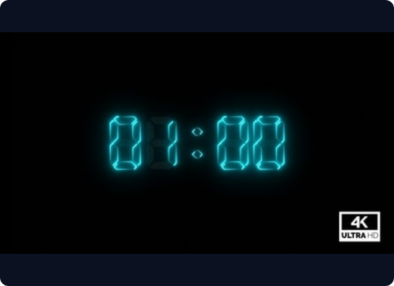
Module 5: Real-Time Monitor (Khaled)
Non-Blocking Kernel Design
The system avoids standard delay functions, utilizing a custom cooperative multitasking scheduler to ensure continuous operation.
▹
Scheduler Base: Timer0 hardware peripheral generates precise 1ms system ticks.
▹
Cooperative Multitasking: Defined tasks execute periodically without ever blocking the main loop execution.
▹
Keypad Scanning: Non-blocking polling mechanism utilizing edge detection software debouncing.
▹
Sensor Updates: Asynchronous ADC polling for the LM35 (Temp) and LDR (Light).

Slide 10
System Architecture & Project Summary
Layered Software Architecture
Summary of Achievements
The codebase strictly follows an industry-standard layered approach for high portability and decoupled maintenance.
The team successfully delivered a highly capable embedded system meeting all design constraints.
▹
APP Layer (Application Logic)
└─
Authentication, Operating Modes
▹
Deployed a fully functional smart home control ecosystem.
└─
Alarm Logic, Event Logging, Scheduler
▹
Engineered a professional, scalable layered software architecture.
▹
HAL Layer (Hardware Abstraction)
Achieved highly efficient resource utilization (Only 24% RAM and 26% Flash used on ATmega32).
└─
LCD, Keypad, LED, Relay Modules
▹
└─
Buzzer, LM35 (Temp), LDR (Light)
MCAL Layer (Microcontroller Drivers)
└─
DIO, ADC, UART, Timer0, EXTI, EEPROM

